Slide 1
The Unseen Observer
Spyware in Our Digital Lives

Slide 2

What exactly is spyware?
Spyware is malicious software designed to infiltrate your device, gather information about you and your activities without your knowledge or consent, and send that data to a third party

Slide 3

Spyware History
The history of spyware mirrors the history of personal computing. The term itself became common in the mid-1990s, but the concept is older. It's a journey from nuisance adware to a powerful, global surveillance ecosystem.

Slide 4
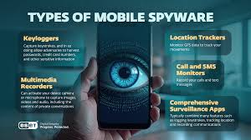



Spyware Examples
Examples range from the relatively benign but intrusive adware that tracks your browsing to serve you targeted ads, to more dangerous forms

Slide 5
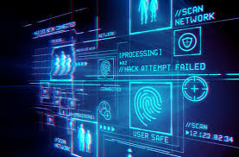
How does this negatively affect our lives?

Slide 6
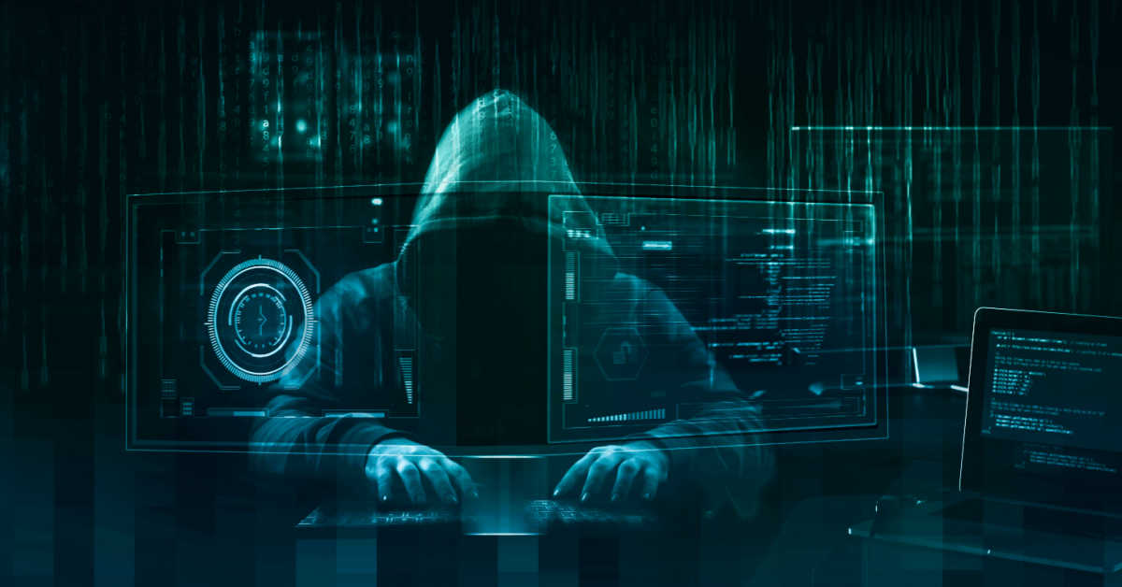
How can we fight back and protect ourselves?

Slide 7
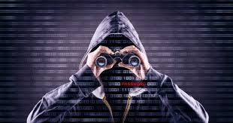
Conclusion
Spyware represents one of the most insidious threats in the digital age. It commodifies our privacy, jeopardizes our security, and undermines the trust that our connected world is built upon

Slide 8
Заголовок слайда

